Slide 1
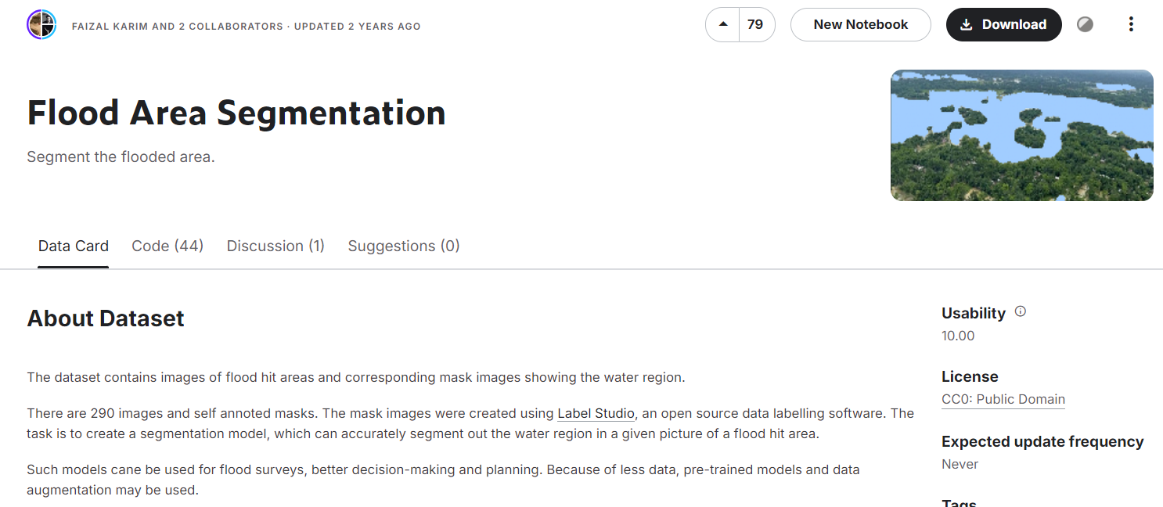
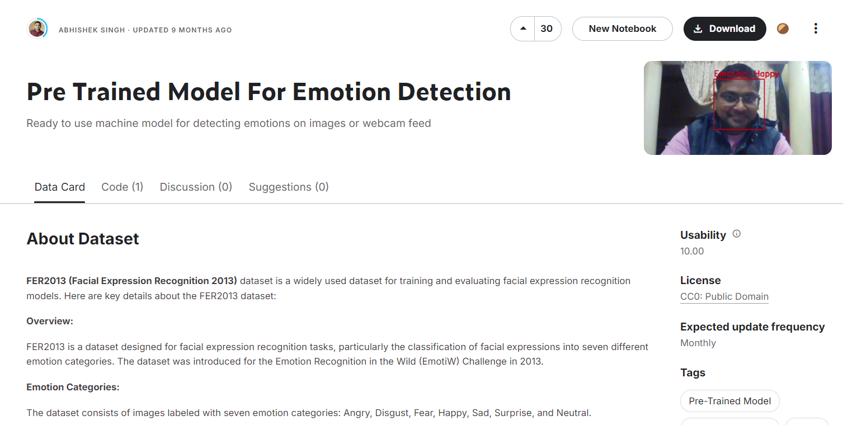
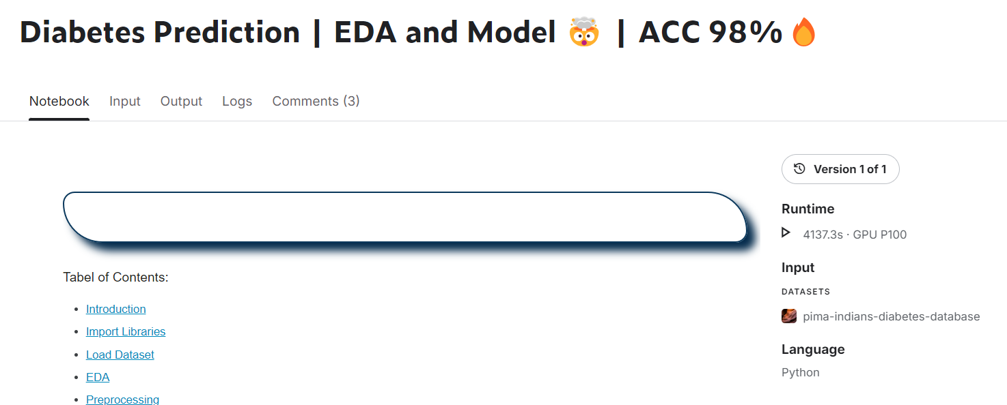
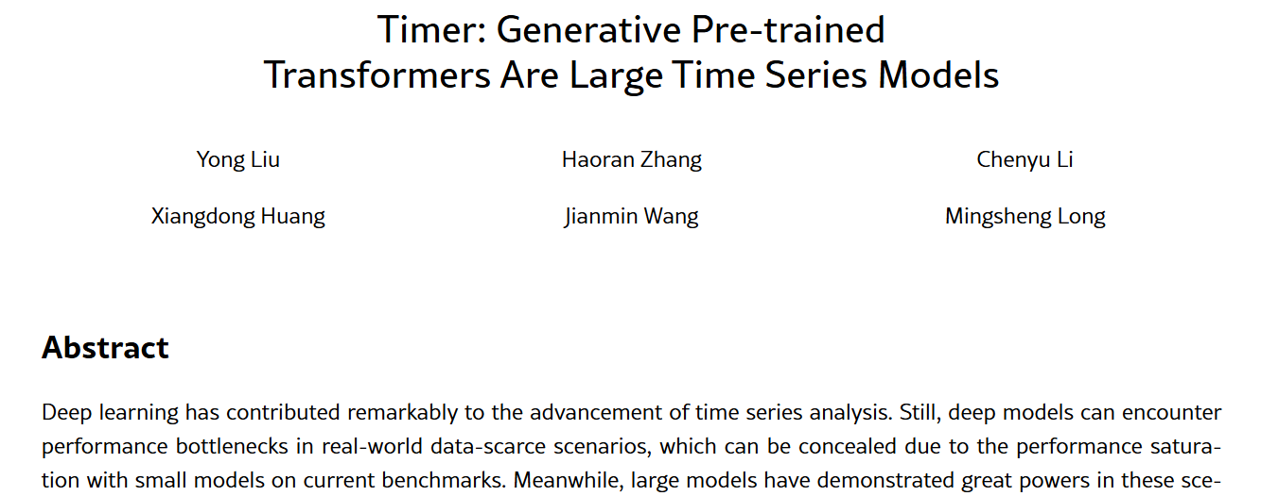
Use cases demonstrated as Business App
Image Analytics
Video Analytics
Flood Area Segmentation
Pre Trained Model For Emotion Detection
Numerical Data Analytics
Time Series Data Analytics
https://arxiv.org/html/2402.02368v3
Diabetes Prediction | EDA and Model 🤯 | ACC 98%🔥
Code and datasets are available at: https://github.com/thuml/Large-Time-Series-Model.

